Slide 1
Artificial Intelligence Planning Introduction and Overview 智能规划概述
2018/7/16

Slide 2
He who fails to plan, plans to fail. —Winston Churchill
Notes:
类似中国的：预则立，不预则废
引出规划的重要性。我们使用计算机的方法研究规划。
通篇主要分为3部分： 第一：介绍经典规划，同时介绍规划在游戏中的应用。 第二：介绍不确定性规划（概率规划）。应用介绍AlphaGo中的UCT算法。 第三：介绍我们的工作：我们主要研究并行概率规划。使用RDDL语言。介绍我们的成果。

Slide 3
Human Planning and Acting
acting without (explicit) planning:
when purpose is immediate
when performing well-trained behaviours
when course of action can be freely adapted
acting after planning:
when addressing a new situation
when tasks are complex
when the environment imposes high risk/cost
when collaborating with others
people plan only when strictly necessary
Notes:
Human Planning and Acting
humans rarely plan before acting in everyday situations
acting without (explicit) planning: (may be subconscious)
when purpose is immediate (e.g. switch on computer)
when performing well-trained behaviours (e.g. drive car)
when course of action can be freely adapted (e.g. shopping)
acting after planning:
when addressing a new situation (e.g. move house)
when tasks are complex (e.g. plan this course)
when the environment imposes high risk/cost (e.g. manage nuclear power station)
when collaborating with others (e.g. build house)
people plan only when strictly necessary
because planning is complicated and time-consuming (trade-off: cost vs. benefit)
often we seek only good rather than optimal plans

Slide 4
Defining AI Planning
Planning:
explicit deliberation process that chooses and organizes actions by anticipating their outcomes
aims at achieving some pre-stated objectives
AI planning:
computational study of this deliberation process
Notes:
Defining AI Planning
planning:
explicit deliberation process that chooses and organizes actions by anticipating their outcomes
in short: planning is reasoning about actions
aims at achieving some pre-stated objectives
or: achieving them as best as possible (planning as optimization problem)
AI planning:
computational study of this deliberation process

Slide 5
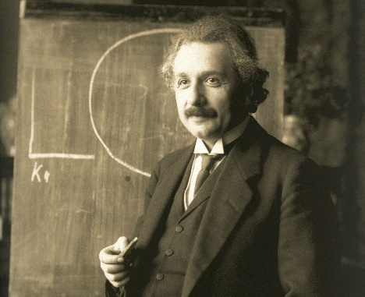
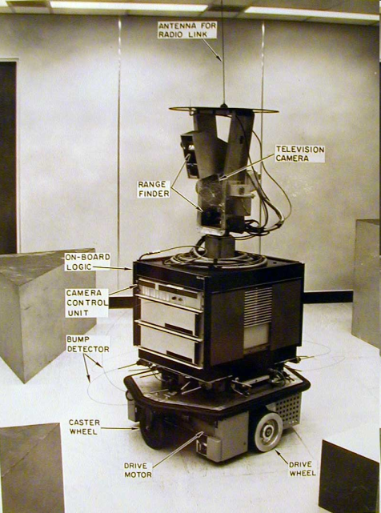
Why Study Planning in AI?
scientific goal of AI: understand intelligence
planning is an important component of rational (intelligent) behaviour
engineering goal of AI: build intelligent entities
build planning software for choosing and organizing actions for autonomous intelligent machines
Notes:
Why Study Planning in AI?
scientific goal of AI: understand intelligence
planning is an important component of rational (intelligent) behaviour
planning is part of intelligent behaviour
engineering goal of AI: build intelligent entities
build planning software for choosing and organizing actions for autonomous intelligent machines
example: Mars explorer (cannot be remotely operated)
robot: Shakey, SRI 1968

Slide 6

Deliberative Acting
Notes:
一个视频：苏格兰乌鸦取瓶子里的食物
New Caledonian crow trying to use a piece of wire to get food that’s out of reach, figures out it won’t work
Figures out how to brace the wire to bend it into a hook, uses the hook to get the food

Slide 7
模型、语言、规划器
规划器用于求解一类模型，它接受模型描述，计算输出相应的控制。
模型
规划器
控制器
模型可以用规划语言描述(Strips, PDDL, PPDDL, …)
Notes:
介绍模型，语言，规划器
Computational Approaches to Classical Planning
• General Problem Solver (GPS) and Strips (50’s-70’s): mean-ends analysis,
decomposition, regression, . . .
• Partial Order (POCL) Planning (80’s): work on any open subgoal, resolve
threats; UCPOP 1992
• Graphplan (1995 – 2000): build graph containing all possible parallel plans up
to certain length; then extract plan by searching the graph backward from Goal
• SATPlan (1996 – . . . ): map planning problem given horizon into SAT problem;
use state-of-the-art SAT solver
• Heuristic Search Planning (1996 – . . . ): search state space S(P) with heuristic
function h extracted from problem P
• Model Checking Planning (1998 – . . . ): search state space S(P) with
‘symbolic’ Breadth first search where sets of states represented by formulas
implemented by BDDs . . .

Slide 8
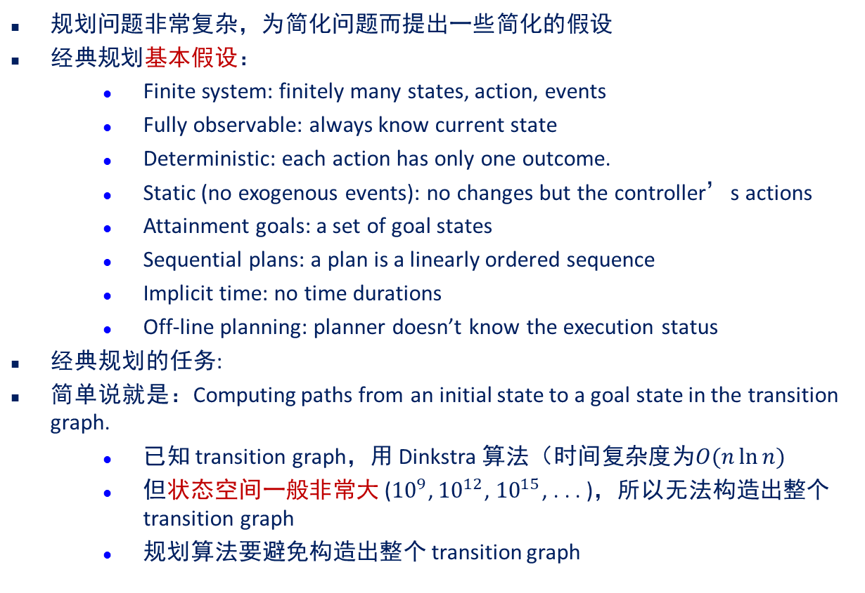
经典规划
规划问题非常复杂，为简化问题而提出一些简化的假设
经典规划基本假设：
Finite system: finitely many states, action, events
Fully observable: always know current state
Deterministic: each action has only one outcome.
Static (no exogenous events): no changes but the controller’s actions
Attainment goals: a set of goal states
Sequential plans: a plan is a linearly ordered sequence
Implicit time: no time durations
Off-line planning: planner doesn’t know the execution status
经典规划的任务:
简单说就是：Computing paths from an initial state to a goal state in the transition graph.
已知 transition graph，用 Dinkstra 算法（时间复杂度为$O(n\ln{n})$
但状态空间一般非常大 (${10}^{9}$, ${10}^{12}$, ${10}^{15}$, . . . )，所以无法构造出整个 transition graph
规划算法要避免构造出整个 transition graph

Slide 9
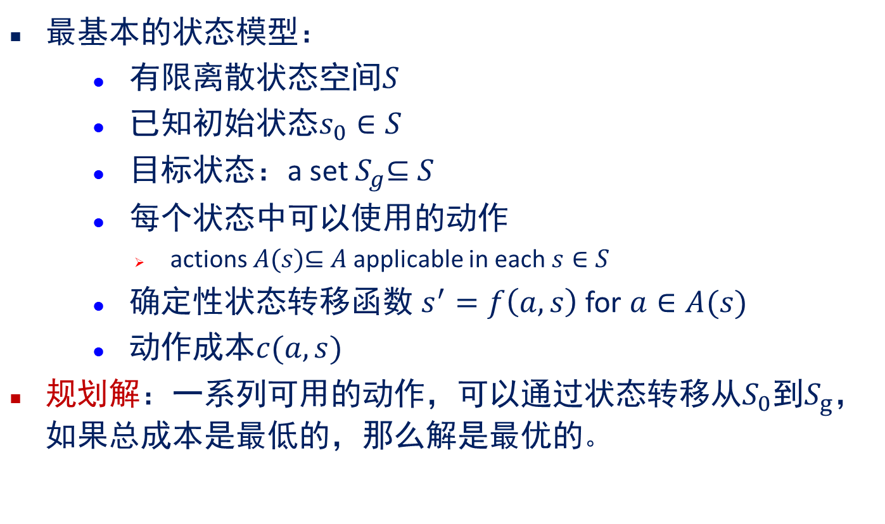
经典规划
最基本的状态模型：
有限离散状态空间$S$
已知初始状态$s_{0}∈S$
目标状态：a set $S_{g}$⊆ $S$
每个状态中可以使用的动作
actions $A(s)$⊆ $A$ applicable in each $s∈S$
确定性状态转移函数 $s^{′}=f\left(a,s\right)$ for $a∈A(s)$
动作成本$c(a,s)$
规划解：一系列可用的动作，可以通过状态转移从$S_{0}$到$S_{g}$，如果总成本是最低的，那么解是最优的。
Notes:
finite and discrete state space S
a known initial state s0 ∈ S
a set SG ⊆ S of goal states
actions A(s) ⊆ A applicable in each s ∈ S
a deterministic transition function s0 = f(a, s) for a ∈ A(s)
positive action costs c(a, s)
A solution is a sequence of applicable actions that maps s0 into SG, and it is optimal if it minimizes sum of action costs (e.g., # of steps)

Slide 10
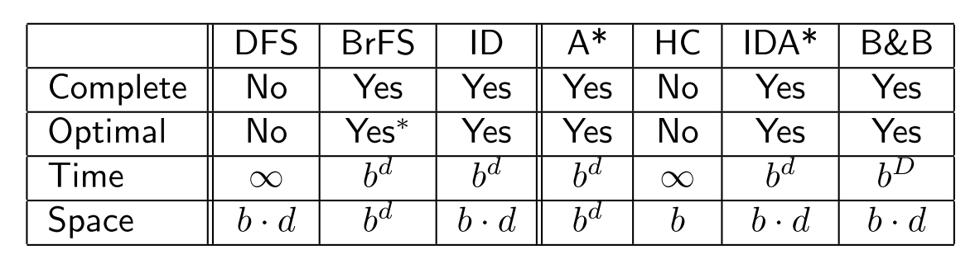
经典规划算法
Completeness: whether guaranteed to find solution
Optimality: whether solution guaranteed to be optimal
Time Complexity: how time increases with size
Space Complexity: how space increases with size
– Parameters: d is solution depth; b is branching factor
– Breadth First Search (BrFS) optimal when costs are uniform
– A*/IDA* optimal when h is admissible; h ≤ h∗

Slide 11
经典规划求解
GPS(General Problem Solver )和Strips(50’s-70’s): MEA(mean-ends analysis), decomposition, regression
Partial Order(POCL) Planning(80’s)
Graphplan (1995 - 2000): 建立包含所有一定长度的并行规划的图，通过从目标反向搜索得到规划解。
SATPlan(1996 -…): 将给定步长(horizon)的问题转化成SAT问题，使用先进的SAT求解器。
Heuristic Search Planning(1996 – . . . ): 使用启发式搜索算法解决规划问题。
Model Checking Planning (1998 – . . . ): 模型检验规划，将模型状态使用DD(决策图)表示，使用基于“符号(symbolic)”搜索算法解决规划问题。
Notes:
MEA:
https://en.wikipedia.org/wiki/Means-ends_analysis
How Means end's Analysis works
The MEA technique is a strategy to control search in problem-solving. Given a current state and a goal state, an action is chosen which will reduce the difference between the two.
partial order causal link (POCL) planner
Computational Approaches to Classical Planning
• General Problem Solver (GPS) and Strips (50’s-70’s): mean-ends analysis,
decomposition, regression, . . .
• Partial Order (POCL) Planning (80’s): work on any open subgoal, resolve
threats; UCPOP 1992
• Graphplan (1995 – 2000): build graph containing all possible parallel plans up
to certain length; then extract plan by searching the graph backward from Goal
• SATPlan (1996 – . . . ): map planning problem given horizon into SAT problem;
use state-of-the-art SAT solver
• Heuristic Search Planning (1996 – . . . ): search state space S(P) with heuristic
function h extracted from problem P
• Model Checking Planning (1998 – . . . ): search state space S(P) with
‘symbolic’ Breadth first search where sets of states represented by formulas
implemented by BDDs . . .

Slide 12
经典规划求解
FF(Forward Search) 2000
LPG 2002 Local Search, panning graphs converted to CSPs
LAMA 2008 (Fast downward search with FF heuristic) Satisicing
GAMER 2008 (model checking, bidirectional search)
Notes:
MEA:
https://en.wikipedia.org/wiki/Means-ends_analysis
How Means end's Analysis works
The MEA technique is a strategy to control search in problem-solving. Given a current state and a goal state, an action is chosen which will reduce the difference between the two.
partial order causal link (POCL) planner
Computational Approaches to Classical Planning
• General Problem Solver (GPS) and Strips (50’s-70’s): mean-ends analysis,
decomposition, regression, . . .
• Partial Order (POCL) Planning (80’s): work on any open subgoal, resolve
threats; UCPOP 1992
• Graphplan (1995 – 2000): build graph containing all possible parallel plans up
to certain length; then extract plan by searching the graph backward from Goal
• SATPlan (1996 – . . . ): map planning problem given horizon into SAT problem;
use state-of-the-art SAT solver
• Heuristic Search Planning (1996 – . . . ): search state space S(P) with heuristic
function h extracted from problem P
• Model Checking Planning (1998 – . . . ): search state space S(P) with
‘symbolic’ Breadth first search where sets of states represented by formulas
implemented by BDDs . . .

Slide 13
经典规划的研究现状
自从Graphplan提出之后有了长足的进步
实证方法
标准的PDDL语言
可用的规划器和基准；规划竞赛
关注规划器表现和可扩展性
大规模问题的求解(非最优)
对于问题不同的表示和想法
Planning as Heuristic Search
Planning as SAT
Other: Local Search (LPG), Monte-Carlo Search (Arvand), . . .
限制
有限状态，静态环境
不能模拟非确定性
……
Notes:
State of the Art in Classical Planning
significant progress since Graphplan • empirical methodology . standard PDDL language . planners and benchmarks available; competitions . focus on performance and scalability • large problems solved (non-optimally) • different formulations and ideas 1. Planning as Heuristic Search 2. Planning as SAT 3. Other: Local Search (LPG), Monte-Carlo Search (Arvand), . . .
局部搜索
https://zh.wikipedia.org/wiki/%E5%B1%80%E9%83%A8%E6%90%9C%E7%B4%A2
Arvand: the Art of Random Walks
LPG
https://www.aaai.org/Library/AIPS/2002/aips02-002.php
LPG: A Planner Based on Local Search for Planning Graphs with Action Costs
limitations: . Does not model Uncertainty (no probabilities) . Does not deal with Incomplete Information (no sensing) . Does not accommodate Preferences (simple cost structure)

Slide 14

Planning in Game
Controller
input
task
execution
Orders
daemons
World state
planner
Plan
Messages
Threats
perception
stimuli

Slide 15
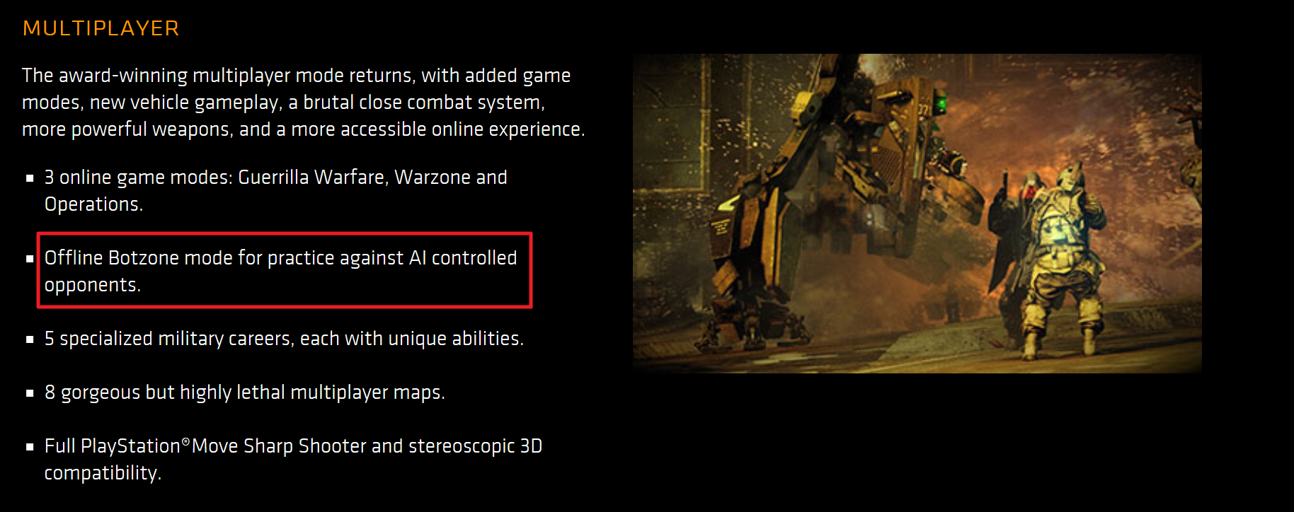
Hierarchical Task Network (HTN)
Killzone 3
“First-person shooter” game
Special-purpose AI planner
Plans enemy actions at the squad level
Subproblems; solution plans are maybe 4–6 actions long
Quickly generates a plan for a subgoal
Replans several times per second as the world changes
Why it worked:
Don’t want to get the best possible plan
Need actions that appear believable and consistent to human users
Need them very quickly
Notes:
https://www.killzone.com/en_IE/killzone3.html
Killzone 3
“First-person shooter” game
Special-purpose AI planner
Plans enemy actions at the squad level
Subproblems; solution plans are maybe 4–6 actions long
Different planning algorithm than what we’ve discussed so far
Hierarchical refinement as in Chapter 3
Quickly generates a plan for a subgoal
Replans several times per second as the world changes
Why it worked:
Don’t want to get the best possible plan
Need actions that appear believable and consistent to human users
Need them very quickly

Slide 16

Probabilistic planning
Motivation: Situations where actions have multiple possible outcomes and each outcome has a probability
roll-die(d)
pre: holding(d) = true
eff:
1/6: top(d) ← 1
1/6: top(d) ← 2
1/6: top(d) ← 3
1/6: top(d) ← 4
1/6: top(d) ← 5
1/6: top(d) ← 6

Slide 17
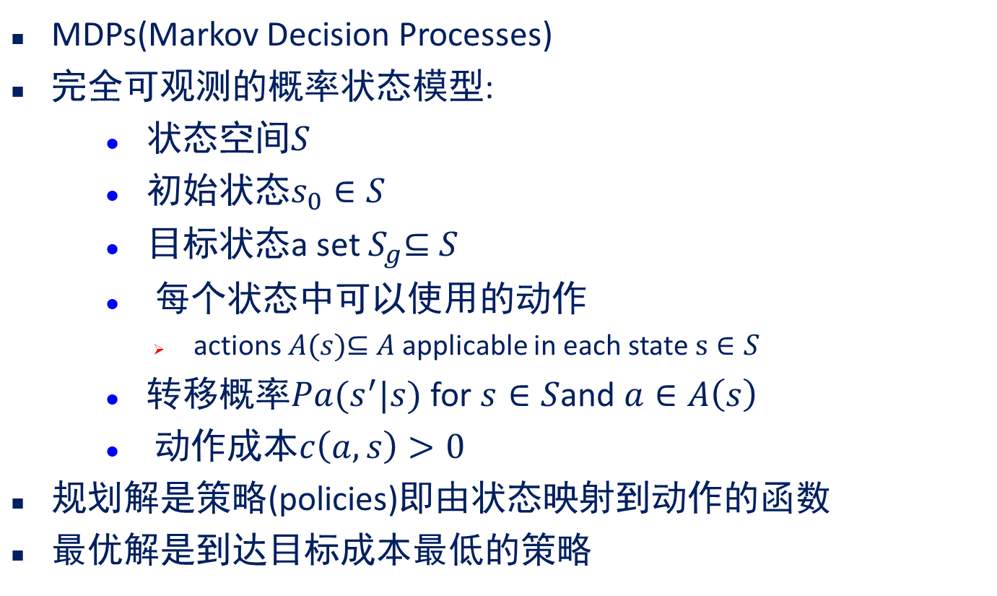
Probabilistic planning
MDPs(Markov Decision Processes)
完全可观测的概率状态模型:
状态空间$S$
初始状态$s_{0}∈S$
目标状态a set $S_{g}$⊆ $S$
每个状态中可以使用的动作
actions $A(s)$⊆ $A$ applicable in each state $s∈S$
转移概率$Pa(s^{′}|s)$ for $s∈S$and $a∈A\left(s\right)$
动作成本$c\left(a,s\right)>0$
规划解是策略(policies)即由状态映射到动作的函数
最优解是到达目标成本最低的策略
Notes:
Probabilistic planning can be solved with iterative methods such as value iteration and policy iteration, when the state space is sufficiently small. With partial observability, probabilistic planning is similarly solved with iterative methods, but using a representation of the value functions defined for the space of beliefs instead of states.
MDPs are fully observable, probabilistic state models:
• a state space S
• initial state s0 ∈ S
• a set G ⊆ S of goal states
• actions A(s) ⊆ A applicable in each state s ∈ S
• transition probabilities Pa(s'|s) for s ∈ S and a ∈ A(s)
• action costs c(a, s) > 0
– Solutions are functions (policies) mapping states into actions
– Optimal solutions minimize expected cost to goal

Slide 18
Probabilistic planning
Basic Algorithms
Value Iteration and Asynchronous Value Iteration
Policy Iteration
Linear Programming
Heuristic Search Algorithms
Real-Time Dynamic Programming
LAO*
Labeled Real-Time Dynamic Programming
Monte-Carlo Planning
Sparse Sampling
UCT

Slide 19

Multi-Arm Bandit
Statistical model of sequential experiments
Name comes from a traditional slot machine (one-armed bandit)
Multiple actions
Each action provides a reward from a probability distribution associated with that specific action
Objective: maximize the expected utility of a sequence of actions
Exploitation vs exploration dilemma:
Exploitation: choosing an action that you already know about, because you think it’s likely to give you a high reward
Exploration: choosing an action that you don’t know much about, in hopes that maybe it will produce a better reward than the actions you already know about

Slide 20
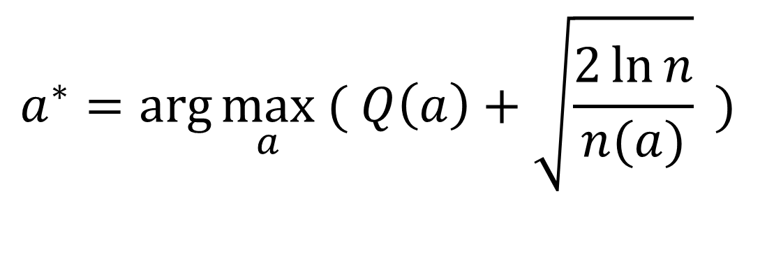
UCB (Upper Confidence Bound) Algorithm
Balance Exploitation and Exploration
$$a^{∗}=arg\max_{a}{( Q\left(a\right)+\sqrt{\frac{2\ln{n}}{n(a)}}}{ ) }$$
Value Term
Exploration Term
Value Term: favors actions that looked good historically
Exploration Term: actions get an exploration bonus that grows with ln(n)
20

Slide 21
UCT: An MCTS Algorithm
UCT
Plans online finds best action for the current state
Similar to learning a policy for a multi-armed bandit
Success stories:
AlphaGo
General Game Playing Competition
Real-Time Strategy Games
Probabilistic Planning Competition (2011, 2014)PROST planner
The list is growing…

Slide 22

Example: AlphaGo
Program to play go
2015: first go program to beat a professional go player
2016: first program to beat one of the world’s top go players
2017: AlphaGo Zero beats all previous versions
Uses a UCT-like learning algorithm to train some artificial neural networks

Slide 23
AlphaGo: Training
Policy network
Give it examples of moves experts would make in various situations
(input, output) pair: (position, expert move)
Resulting neural network:
input: position → output: probability distribution over moves
Do some optimization to make it work better
Value network
Use the policy network to play games against itself
Use the results to train another deep neural network
(input, output) pair: (position, who won)
Resulting neural network:
input: position → output: expected utility

Slide 24
小结：经典规划
经典规划有如下三个限制：
确定性 (determinism)，但现实情况更多是不确定的：
由于信息的不完全，我们不能确定具体在哪个状态。Uncertainty about the state of the world.
行动的结果可能是不确定的。Uncertain effects for actions.
在执行决策的过程中，外部事件可能改换世界。External events.
完全可观察性 (full observability)，但实际情况更多的是部分可见 可达性目标 (reachability goals)，由于动作结果的不确定和可能的执 行失败，目标也相应扩展的更灵活，主要有两种：
效用函数，规划求解的任务是使得效用函数的值最大化
用时态逻辑公式表达目标，规划求解的任务是使得，规划中行动令此时态公式为真

Slide 25
小结：概率规划
使用MDP/POMDP 可以数学的刻画不确定性条件下的规划规划，
相关研究是持续多年的热点
对于使用MDP/POMDP 也有不同声音：
MDP 需要考虑state space explosion 问题
require structured representations, exploit regularities in probabilities, rewards. 而 AI 的技术一般更natural, concise (STRIPS, Bayesian networks)
require structured computation, exploit regularities in policies, value functions, can aid in approximation.

Slide 26
Thanks!

